Slide 1
LNL-M Customer X-ray Inspection Process Questions
OEM | ODM | Product | LNL-M PCBA X-ray Inspection Process Flow (till PRQ) | LNL-M PCBA X-ray Inspection Process Flow (Post PRQ)
Dell | Compal | Tributo | 100% x-ray to inspect SBB | - Sampling check every xxx boards/xx hours (depends on customer request) - Failing board debug to confirm there is/is not CPU SJ failure - SJ inspection after rework/replaced a BGA
HP | Quanta | Regis | Same | same
MSFT | JDM1 |  | Same | same

Slide 2
X-ray machine make/model that will be used for LNL-M PCBA inspection?
State Xray (Failure Analysis) Supplier Name, Model# and Year of Manufacture, used for Intel BGA?
Compal CD | Compal CQ | Compal KS (Dell) | HuaQin | Inventec CQ (HP)
Nordson/Dage-XD7500VR | Dage -XD7500/ Year 2007 | NA (Customer didn’t answer, should be same with Compal CD – Dage XD7500VR | phoenix xlaminer MXCN000619-332618 March 2019 | SEC X-eye SF160 2013/04/25
LCFC (Lenovo) | MSI | Pega SZ (JDM1/MSFT) | Quanta CQ (HP) | Wistron
Nordson/Dage-Quadra6-Year2018 | Old machine, 15 years ago | Dage 7600NT | Nordson/Dage-Quadra7 | Dage & TRI
Data source: 2021 MTL CRD

Slide 3
Tube Voltage and Power of the X-ray machine (Max and Normal usage value for LNL-M)
Customer | Segment | X-Ray Machine Brand and Model | Tube voltage Typical | Tube power Typical | Typical scan time | Working distance (typical)
Compal | Client | Dage XD6500 | MAX:160kv Normal: 100KV | Max:3w | 35s | Not able to provide
Inventec | Client | SEC and X-eye SF160 | 160kVP | 32W | 1.5min/pcs | 0.3m
Pegatron | Client | Brand：YXLON Model:Cougar SMT | 100KV | 10ua | Not able to define(depends on X-Ray locations and qty). | Not able to define
ODM4 (Pegatron) | Client | PHOENIX; model: ANALYSER 160 | 160kv | 20w | No standard inspection time, depends on on FA purpose or FAI validation. | 310mm
Quanta | Client | Dage XD7600NT | 90KV | 1.2W | /(per sample size) | 90mm
Wistron | Client | Brand: Dage Model: XD7500NT | Max voltage: 160KV Normal usage: 80kv~110kv | Max power: 3w Normal usage: 1.0~1.5W | <1min | Not allow anybody within 1m range except X-Ray machine operator.
Inventec | Server | Vitrox V810xxl S2i | 130 kV | 30mA | 8inch²/s | 2.5cm for the above and 8 cm for below
Quanta | Server | Agilent 5DX 5000 | 160KV | 16W | 120S | 30cm
Quanta | Server | ViTrox V810 | 130KV | 26W | 100S | 30cm
Data source: 2019 KBL G X-ray Exposure Survey

Slide 4
LNL-M PCBA inspection time (Total inspection time of LNL-M BGA including AXI and MXI)
So far, I don’t see client ODM use AXI, all of them use offline MXI
Total inspection time varies, typical normal operation (quick scan of SBB issue) 0.5~2min. Can up to 5~10min when engineering judgement is need to inspect suspect SJO issue
Instant survey at 2/29/2024. The reply reflects ODM x-ray inspection practice for normal PCBs, doesn’t consider the requirement of SJ void inspection which is special for RH process
JDM1 (MSFT) | Compal (Dell) | Inventec (HP) | LCFC (Lenovo) | Quanta (HP)
Q1: What is your HVM x-ray inspection sampling rate?
1% | 1 panel per 2 hours | 2 panels per 4 hours | 1 panel per 2 hours per SMT line | 2 panels per work order
Q2: Do you inspect only 1 board a time or inspect multiple boards at same time?
For inspect efficiency, depends on board size, we put 2~4 panels (4~8 boards) into x-ray machine to inspect at the same time | For inspect efficiency, depends on board size, we will put multiple panels into x-ray machine to inspect at the same time | We can do both | We put only 1 panel to inspect at a time | Yes we inspect multiple panels to improve efficiency
Q3: What is your normal inspection time for x-ray sampling?
X-ray warm up 30s, each board inspect time 30s, total 150~350s (2~4 panels/4~8 boards) | 60s/brd, 120s/panel (normally 2brd/panel) , time will be longer if put multiple panels to inspect together | 60s/brd, 120s/panel (normally 2brd/panel) | X-ray warm up 30s, Inspect CPU 60s, rest of board 60s. Total 120s per board (240s per panel) | 300s (5min) to take photos for a CPU (believe they are talking about SJ void inspection)

Slide 5
LNL-M PCBA inspection rate (100% or sampling). If yes for sampling, please share the sampling rate frequency
In NPI build, 100% scan for SBB issue
During HVM, only sampling check. Sampling rate depends on customer request. Typical operation is 1~2 Pcs per hour

Slide 6
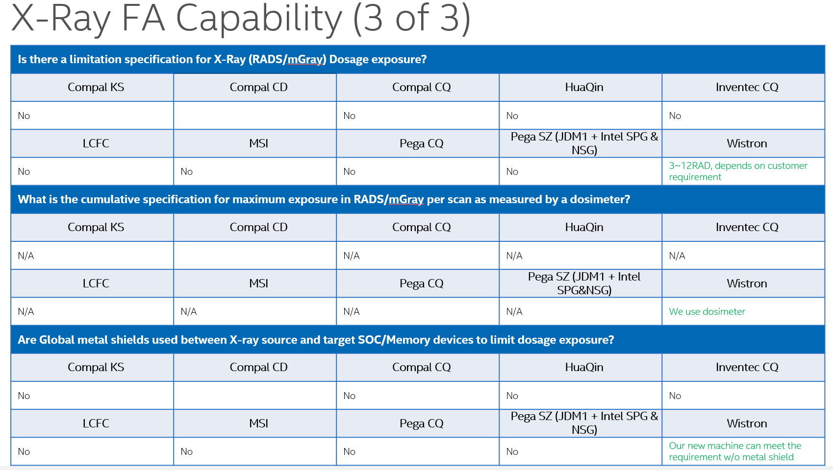
Do you use any filters in the X-ray inspection (AXI and MXI) process to mitigate the Memory X-ray exposure risk? If yes, please share the filter thickness and material
No ODM use filters
Wistron said they can meet 3~12 RAD (30~120 mGy) with their latest machine (measured by dosimeter)
Data source: 2020 ADL CRD

Slide 7
Do you have access to a dosimeter for X-ray exposure measurements? If yes, please mention the supplier and accuracy of the dosimeter
No ODM ever have experience of using dosimeter, except Wistron
X-ray machine vendor normally have connection with dosimeter suppliers

Slide 8
Do you have issues with inspecting the LNL-M package with the package facing away from the X-ray source (AXI and MXI)?
Dage machine have the largest market share among ODMs, per my understanding, Dage machine have x-ray tube at bottom side, and all customers inspect PCBA with BGA facing up (BGA facing way from x-ray source). So it should not be a big issue

